Slide 1


How technology can enhance your classroom
By
Rhonda Wilson-Dowker, Mary Przybyla, Jennifer Irish, and Scot Acre
Notes:
Today we are here to encourage you to use technology in your classrooms.

Slide 2

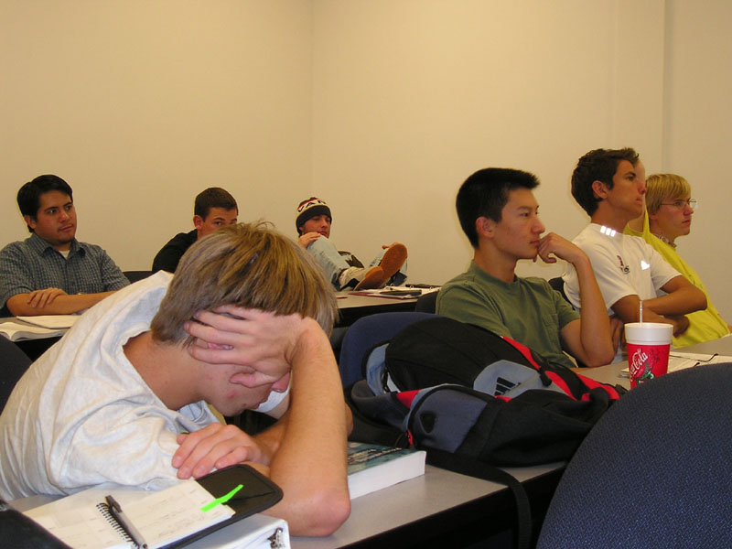

Why?
All images courtesty of Google images
Notes:
So why should we use technology? There are several reasons… First, according to Marzano, non linguistic representations of your content can help motivate students. Today’s students may need visual imagery to jump start things. Technology is a great way to “get away from” simply visiting the textbook with students.

Slide 3
Today…
Traditional teaching
Project based teaching
Idea based teaching

Slide 4
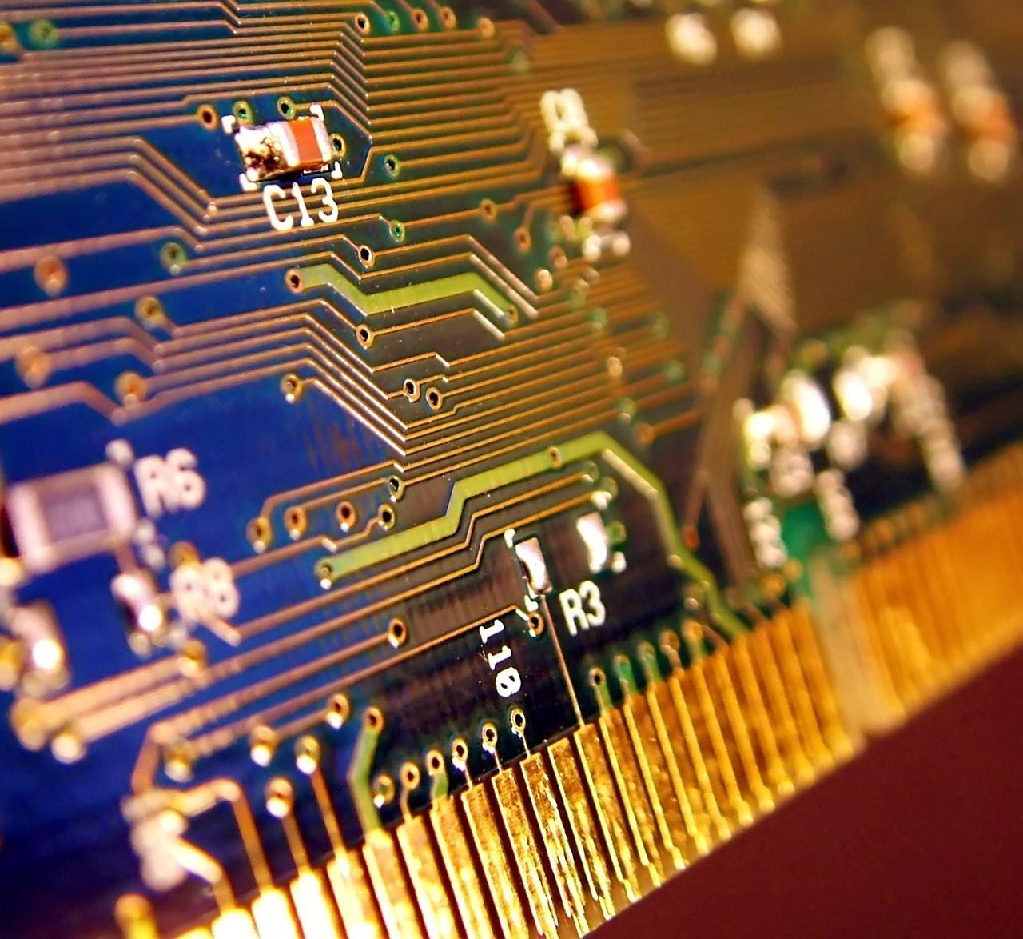

Teaching with technology
Didactic method – content presentation
Word documents PowerPoint Podcasts United Streaming

Slide 5

Word Documents
Outline
  Scaffold
  Student collaboratation
Word documents to work with other technology

Slide 6
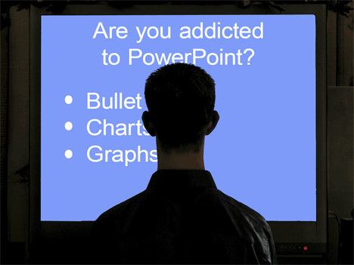
PowerPoint
Photos, maps, diagrams or video
  Introduce new concepts
  Visual interpretations
  Starting point for discussion
  Word documents to guide students

Slide 7

Podcasts
The “real” sound
Individual student pace
  Speeches
  Readings
  Conversations/interviews
  Student involvement
  Word documents to guide

Slide 8

United Streaming
Visuals
  Segments or full features
  Introduce new concepts
    Starts students talking
    Sets a base of “prior knowledge”

Slide 9


Inquiring Minds
(Dils, A. K. 103)
Notes:
We teachers need to tap into the energy of our students. For example, one 8th grade Social Studies teacher challenged his students to have an influence in an up-coming election. Even though they couldn’t vote, they decided to influence the number of voters. With limited technology, they created radio and TV public service announcements and local stations put them on the air. One radio station played their announcement throughout the day of the election. What a great validation of their project (Dils,K. 103).

Slide 10
Inspire
Believe in what you do
Fine-tune and Repeat

Slide 11


Imagine:
Rotating the Earth!
Dr. John Bell, MSU
Notes:
Imagine having each of your students control the rotation of the Earth (Dr. John Bell, MSU)! While moving the Earth, they can see the temperature change and discover the coldest time of the day. They can test and re-test each time of interest. Engaged students! Students learning and discovering through technology!

Slide 12
Basketball!
Math!
Name | Games | Points per Game | Rebounds per Game | Assists per Game
Thomas, I | 82 | 29.6 | 5.9 | 4.3
Jabar, K | 51 | 26.2 | 12.5 | 3.1
Notes:
Inspire your students with a new twist. Reflections, Areas, Vectors and Statistics can be explored through basketball (http://library.thinkquest.org/12006).
The Internet opens up possibilities for our classroom. WebQuest and ThinkQuest are two sources for Inquiry-based projects.

Slide 13
Library/ThinkQuest.org

Slide 14
Scream Machine
TeacherWeb.com

Slide 15
Inquiring Minds
Inspire
Technology

Slide 16
Michigan Education Requirements
For High School Diploma
  (i) Has successfully completed at least 1 course or learning experience that is presented online, as defined by the department.
  ii) The pupil's school district or public school academy has integrated an online experience throughout the
  high school curriculum by ensuring that each teacher of each course that provides the required credits of the Michigan merit curriculum has integrated an online experience into the course.
    http://www.legislature.mi.gov/(hzka3q2cfmj4r0vc4mdmp055)/documents/mcl/pdf/mcl-380-1278a.pdf
    Whether or not teachers are ready, this is the law.

Slide 17
Idea Based Model of Learning
Re-Seeing the world through ideas
Use ideas and images from the students world to make connections to what is being studied
Ideas can be quickly and effectively communicated to students

Slide 18
Idea = Metaphor
Present the idea first with a metaphor
Let Technology help you find a metaphor.
  Example Metaphors
  Use a search engine and type in the search box “education metaphors”
  Google or Yahoo will work!

Slide 19
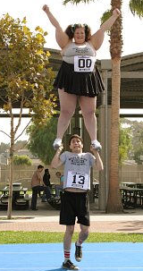
Math Image Metaphor
A chicken and a cow
Famous Scene from the movie Dodge ball

Slide 20
Improper Fractions
Have students create their own image of an improper fraction
  Compile them into a POWERFUL PowerPoint
Access WebQuests that connect fraction terminology to learning.
  A Good One: Impossible Fraction Mission
A WebQuest According to Bernie Dodge, WebQuest inventor and Professor of Educational Technology at San Diego State University, is an “inquiry-oriented activity in which some or all of the information that learners interact with comes from resources on the Internet.” This creates an ideal learning environment.

Slide 21

Science Metaphor
Begin a discussion about how water flows.
Does anything stop water while flowing?
Are there objects water can flow through?
Use this Metaphor to lead to a scientific online simulations.
“With online simulation you are certainly reaching for the platinum standard of teaching practice.” (Wise)

Slide 22
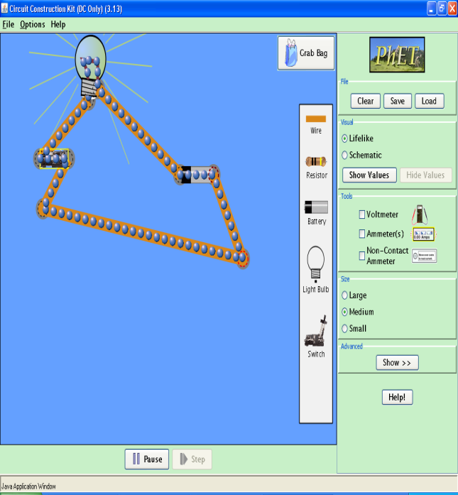
Flow of Electricity
The Internet is full of scientific simulations
This one allows students to create circuits
Electrical Metaphor
Circuit Simulation
The Internet has revolutionized the way we communicate, do business, socialize, and find entertainment. It has transformed work and has pervaded our leisure lives as well. And it has changed the way we educate. (Ross, Schulz)

Slide 23

wilso559@msu.edu
pleasan8@msu.edu
lrishjen@msu.edu
acresco1@msu.edu

Slide 24
Bibliography
PhET, 2007, http://phet.colorado.edu/new/simulations/sims.php?sim=Circuit_Construction_Kit_DC_Only
Electric-Metaphor, 2007, http://www.rattlesnake.com/notions/electric-metaphor.html
Impossible Fraction Mission, 2006, http://usiweb.usi.edu/students/gradstudents/j_k_l/kleinknecht_s/portfolio/Educ%20565%20Comp/fractions%20webquest.html
Glencoe McGraw-Hill Online. Keeping Your Cutting Edge: Methodology and Research to Take to Your Classroom, 2006 http://www.glencoe.com/ps/computered/article.php4?articleId=418&modId=3
Ross, Schulz. Using the World Wide Web to Accommodate Diverse Learning Styles, College Teaching, Vol. 47, 1999
Wise. Integrating Computers and Science Inquiry: The C4E Model, 2005 http://www.techlearning.com/showArticle.php?articleID=161500470

